Slide 1

Do left-handed pitchers have an advantage over right- handed pitchers?
Sports Analytics – Final Project
By Isaac, Jordan, Stephen, Anurag

Slide 2
Objective
In baseball, left-handed pitchers are sought after more than right-handed pitchers due to the unfamiliarity advantage.
A batter, when facing two pitchers of equal skill, is more likely to play worse against the left-handed player as they are not used to it.
Data Collection /Preprocessing:
Collect data of all the pitches thrown over a season of MLB baseball.
Collect historical data of salaries paid to MLB pitchers.
Analytics:
Create metrics to compare the performance of left-handed and right-handed pitchers.
See how being left-handed impacts the salary a pitcher would earn.
Inference:
Evaluate the unfamiliarity advantage by looking at the performance metrics.
Check if a premium is put on left pitchers by the teams by evaluating its impact on salary.
~25%
Proportion of left-handers among MLB pitchers
~10%
Proportion of left-handers in general population

Slide 3
Data Exploration:
Overview of Datasets:
Dataset #1: Kaggle MLB 2015-2019
Games.csv:
Individual game home/away scores
AtBats.csv:
Individual at bat data, including pitcher_id, batter_id, handedness and outcome
Pitches.csv:
Individual pitch data, including location, velocity, movement, spinrate, atbat_id, pitcher_id
We focused on atbat.csv and pitches.csv, where we joined the datasets on atbat_id to aggregate our data
Dataset #2: Lahman database
Pitching.csv:
Wins,earned runs, strikeouts,walks, etc
Salaries.csv:
Player salary spanning from 1985-2016
People.csv:
handedness

Slide 4
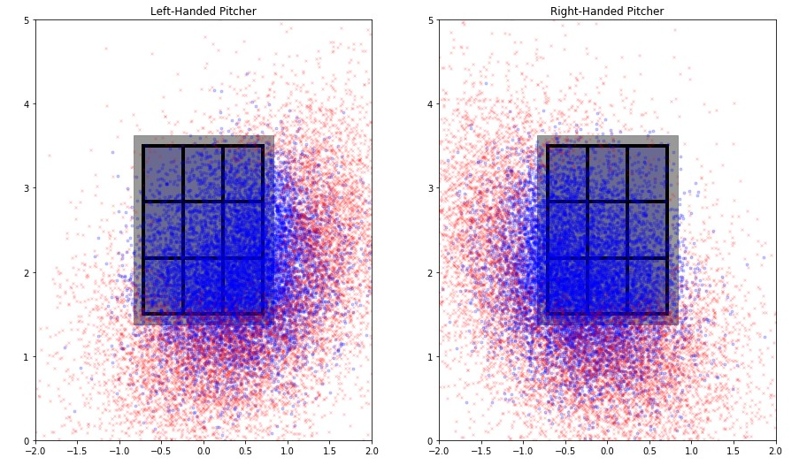
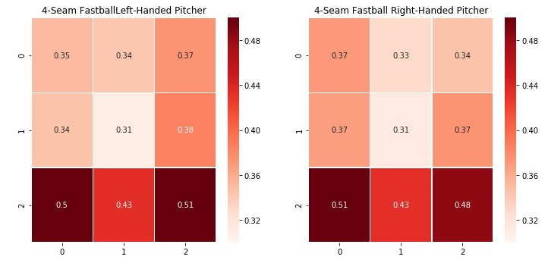
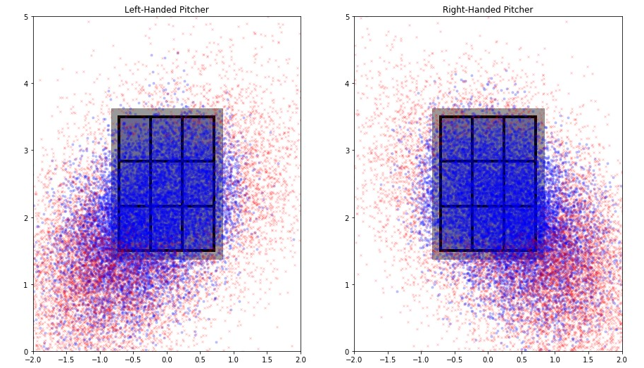
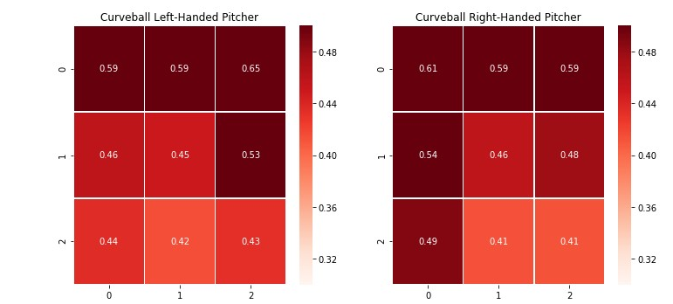
Visualizing Balls and Strikes:
Analyzing the Strike Zone:
Change-Up
Sliders

Slide 5
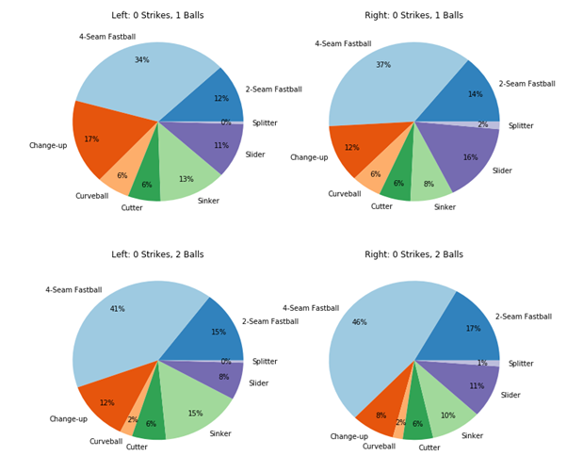
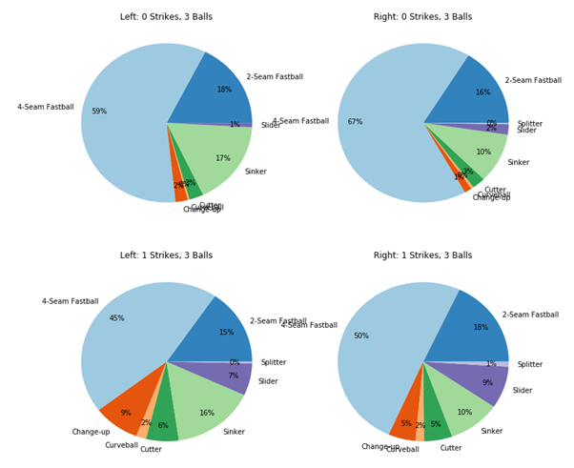
Analyzing Pitch Selection:
LHPs are able to rely less on fastballs and more on off-speed, especially when they are behind in the count

Slide 6
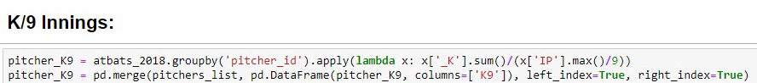
Initial Analysis
Are there stark differences in the performance of LHPs and RHPs?
Are there objective differences in the quality of pitches from LHPs and RHPs?
Does the platoon advantage for LHPs hold true?
 | L | R
BAA | 0.242697 | 0.239857
K9 | 8.677162 | 8.713415
FIP | 3.904079 | 3.985036
WHIP | 1.285686 | 1.260045
Conclusion: Aggregating pitching outcomes for each at-bat for both LHPs and RHPs, any differences seem to be marginal

Slide 7
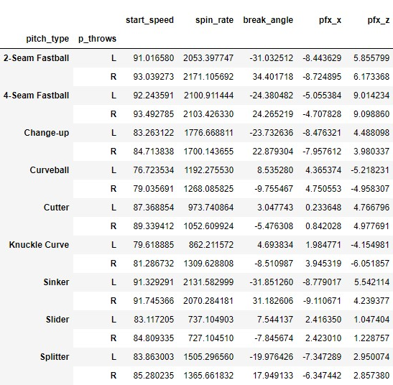
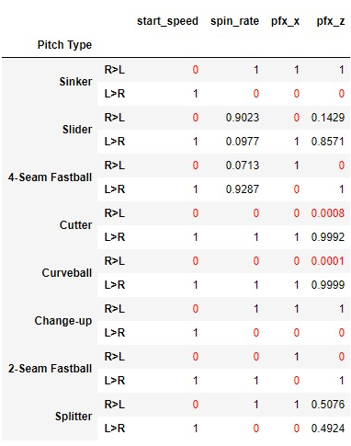
Initial Analysis
Are there stark differences in the performance of LHPs and RHPs?
Are there objective differences in the quality of pitches from LHPs and RHPs?
Does the platoon advantage for LHPs hold true?
T-test to affirm differences between LHPs and RHPs
Conclusion: RHPs throw harder on every pitch-type and often also have higher spin and movement
Notes:
It does appear that some form of the platoon advantage exists - batters facing pitchers on the same side have a lower OPS and for LHPs this also applied to batting average. In terms of strikeouts and walks, we see this trend as well: batters of the opposite side struckout less and walked more. The question to ask then, is how often are left-handed pitchers used to get right-handed batters out, and vice-versa.

Slide 8
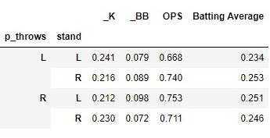
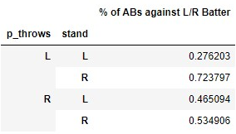
Initial Analysis
Pitching Matchup Performance:
Are there stark differences in the performance of LHPs and RHPs?
Are there objective differences in the quality of pitches from LHPs and RHPs?
Does the platoon advantage for LHPs hold true?
Conclusion:
While the platoon advantage appears to be true, the data suggests that LHPs are not sought after simply because they are better against LHBs
Pitching Matchup Frequency:
Notes:
While LHPs do indeed fare better against LHBs, it seems implausible that they are hired in teams just to be used against LHBs. We see from the frequencies that LHPs only face LHB's 28% of the time, a lower frequency than RHPs face LHBs. This suggests to us that there are many situations where LHPs are not able to use their platoon advantage, since they may not even be substituted in to face LHBs.

Slide 9
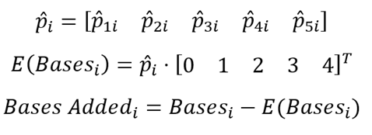
Expected Bases Model
Overview:
Goal: Quantify the value that left-handed pitching has over right-handed pitching
Approach:
Looking at the final pitch of each qualifying at bat, there are 5 outcomes
no hit, single, double, triple or homerun, each corresponding to 0, 1, 2, 3, 4 bases respectively
Train a multi-class classification model on features encapsulating pitch quality
velocity, horizontal movement, vertical movement, location, pitch-type
Fit observations using model to get predicted probabilities for each outcome and a probability-weighted expected bases from each pitch
Notes:
Bases added is the difference between the actual bases and the expected bases: if the actual bases is lower than the expected bases, then the pitcher brought some additional value to the team by reducing runs on his own ability.

Slide 10
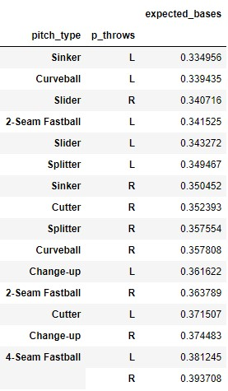
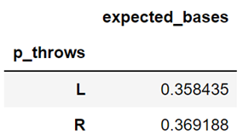
Expected Bases Model
EB by pitch-type
Aggregated EB
Results:
Both multi-class logistic regression and decision trees yield the same result
Using our results, we can identify:
The best pitches thrown by LHPs and RHPs
The mean expected bases for LHPs and RHPs
p-value: 0
Conclusion:
The best pitches in terms of expected bases belong to LHPs, and on average RHPs have higher expected bases on their pitches
Notes:
While LHPs do indeed fare better against LHBs, it seems implausible that they are hired in teams just to be used against LHBs. We see from the frequencies that LHPs only face LHB's 28% of the time, a lower frequency than RHPs face LHBs. This suggests to us that there are many situations where LHPs are not able to use their platoon advantage, since they may not even be substituted in to face LHBs.

Slide 11
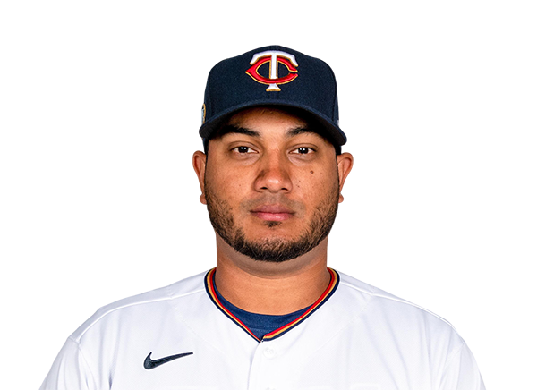





Ranking pitchers by Hits Gained:
What is Hits Gained?
Hits Gained is the extra number of hits a particular pitcher gives away compared to the average pitcher.
Create a logistic regression model predicting all pitches in a season.
Use the model to predict the probability of a hit for each pitch.
Subtract it from the actual outcome to evaluate hit gained.
Outcomes:
The average left-handed pitcher had lower hits gained compared to the average right-handed pitcher. Its significance was confirmed by a t-test.
Out of the 465 pitchers who threw more than 500 pitches, left-handed pitchers on average ranked 17 places higher than right-handed pitchers.
Jhoulys Chacin Julio Teheran Max Scherzer
-136 -133 -129
Martin Perez Matt Moore Homer Bailey 103 123 144

Slide 12
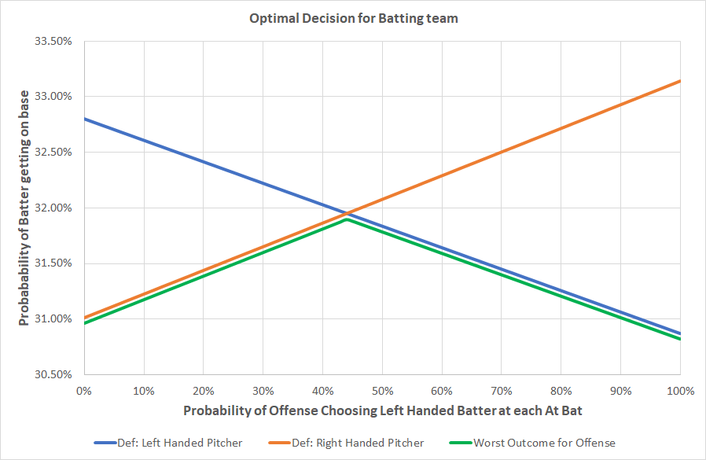
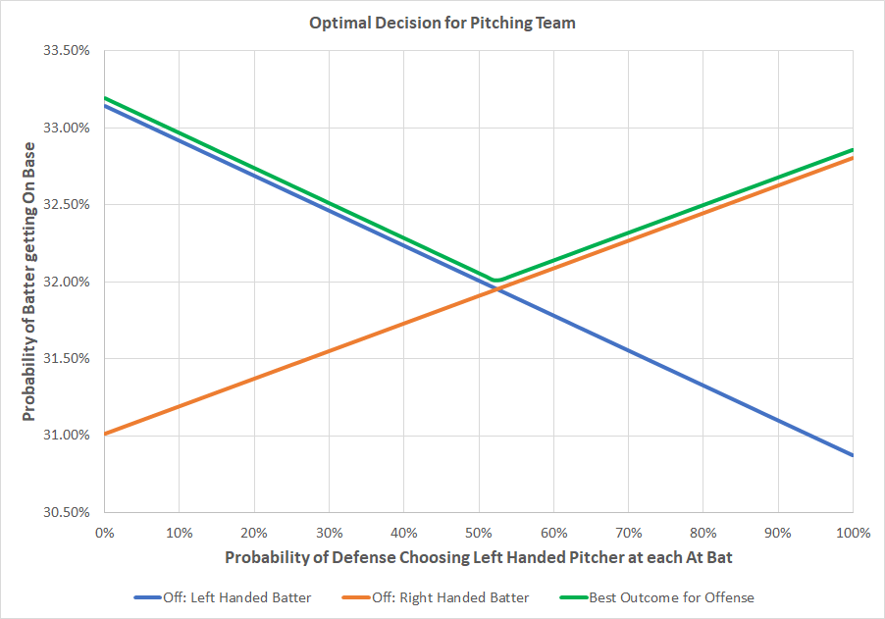
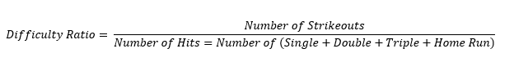
Game Theory
On Base Percentage (OBP)
 | Left-Handed Pitcher | Right-Handed Pitcher
Left-Handed Batter | 30.87% | 33.14%
Right-Handed Batter | 32.81% | 31.01%
44.13%
Pitch Hit Difficulty
 | Left-Handed Pitcher | Right-Handed Pitcher
Left-Handed Batter | 1.07 | 0.903
Right-Handed Batter | 0.921 | 1.00
52.38%

Slide 13
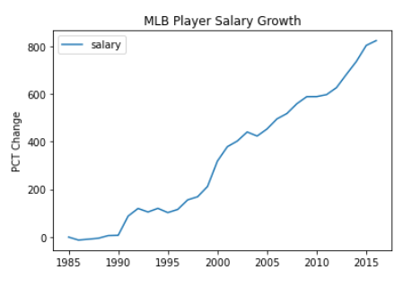
Salary Growth

Slide 14
Data Selection
Look at “Established Players” (Pitchers who had pitched over 6 years)
Segregation between Starting Pitchers and Relief Pitchers

Slide 15
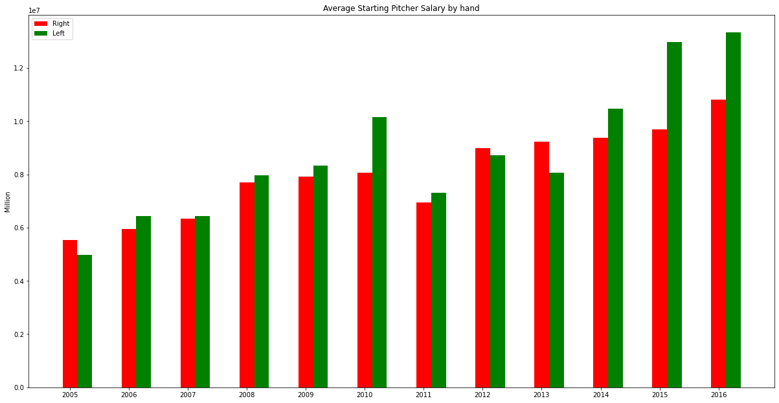
Starting Pitcher Salary Trends

Slide 16
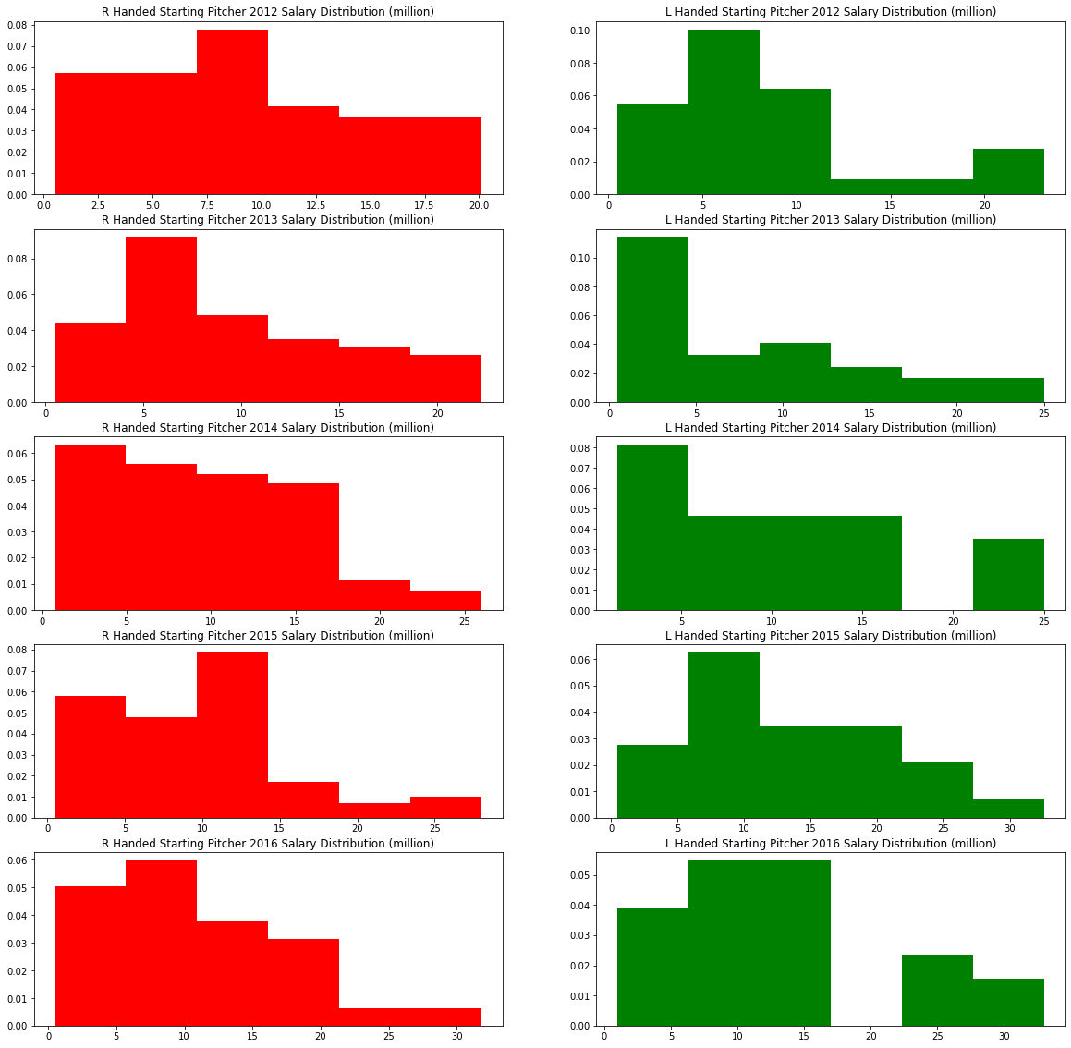
Starting Pitcher Salary Distribution

Slide 17
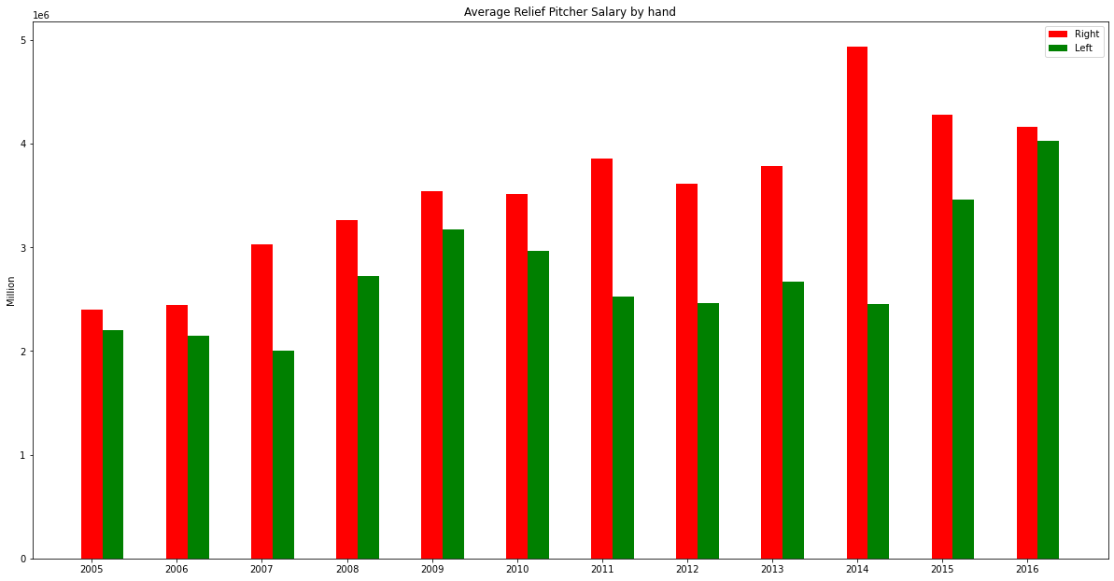
Relief Pitcher Salary Trends

Slide 18
T-test is significant
T-test between left and right-hand starting pitchers
T-test between left and right-hand relief pitchers

Slide 19
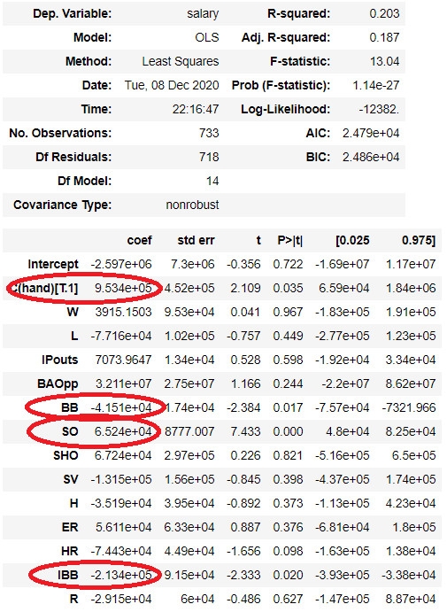
Left-handed, Strikeouts, Walks and
Intentional Walks are statistically significant
Being a left-handed starter makes you earn
an Extra $ 953,400!

